Slide 1
Making Today’s Internet Faster
(Automatic Transition To Peer-to-Peer Download)
Roger Pack
MS Thesis Defense
Notes:
Formal, use third person or I
take out all periods
Fix references…
Fix that one graph

Slide 2
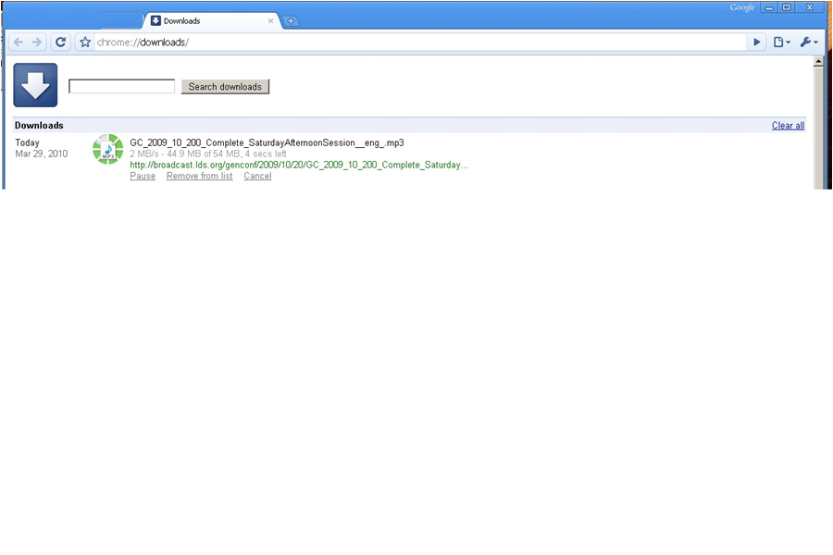
Fast download

Slide 3

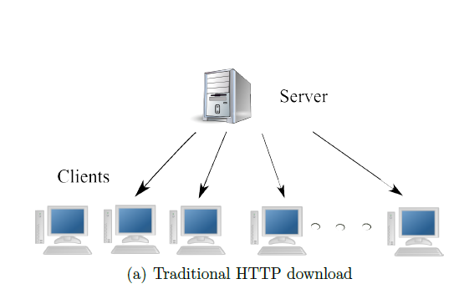
Slow downloads
Relative frustration
Wasted bandwidth
Server under-provisioned
Internet congestion
Flash crowd
Notes:
Serv
Lodo:
Add a graph of network speed increasing so slowly compared to processors and disks (?) (?)

Slide 4
Your options
Wait around.
Parallel download manager.
Add a local caching proxy.

Slide 5

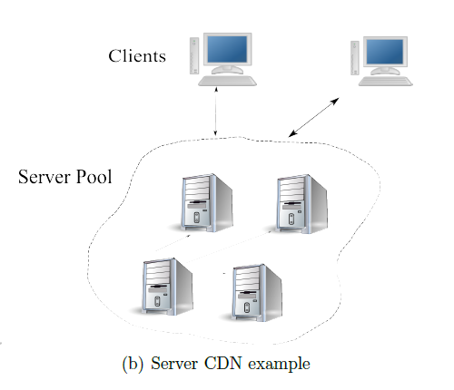
Server options
Buy more bandwidth.
Rent a CDN
Turn to P2P

Slide 6

CDN can fail
Overloaded.
Expensive.

Slide 7

Turn to P2P
BitTorrent
Create + host BitTorrent File.
Run a tracker.
Peers download and share blocks (efficiently).
Works well for large popular files.
“When I created BitTorrent in 2001, my mission was to solve the problem every website has when distributing large, popular files” – Bram Cohen

Slide 8
BitTorrent downsides
Server side.
Per File
Have to provide traditional anyway.
Lack of clients.
Stigma.
Extra maintenance.
Large Files.
Unknown demand.

Slide 9
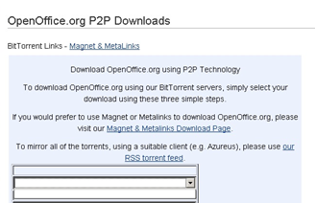
BitTorrent downsides
Clients
Extra setup/time per file.
Small files
Technical expertise
Not integrated.
Manual.
Not HTTP optimized.
Often slower than client-server
Costs time
Warmup phase
Transition ?
Not available.
Notes:
Normal people do not use BitTorrent. Not useful to them.

Slide 10
Related Work
Cs, etc. etc. one example of each
Notes:
The more general problem is that when downloading typical files from the Internet, Bittorrent cannot come to your aid.

Slide 11
Automatic Swarming
Automatic Transition to Peer-to-peer download
Monitor download
Automatically switch if it becomes slow
Overcome deficiencies of BitTorrent
Wouldn’t it be great if this was built into Internet Explorer and Firefox?
Make swarming more adoptable
All downloads

Slide 12
Automatic Swarming -- Goals
Work for any file on any server without configuration.
Easy for client use.
No extra hardware.
Work for small files.
Non intrusive
Don’t cache other people’s files.
Legal.
Notes:
Also: only go to P2P when necessary (try to always be as fast as normal download).
These goals overcome those deficiencies.

Slide 13
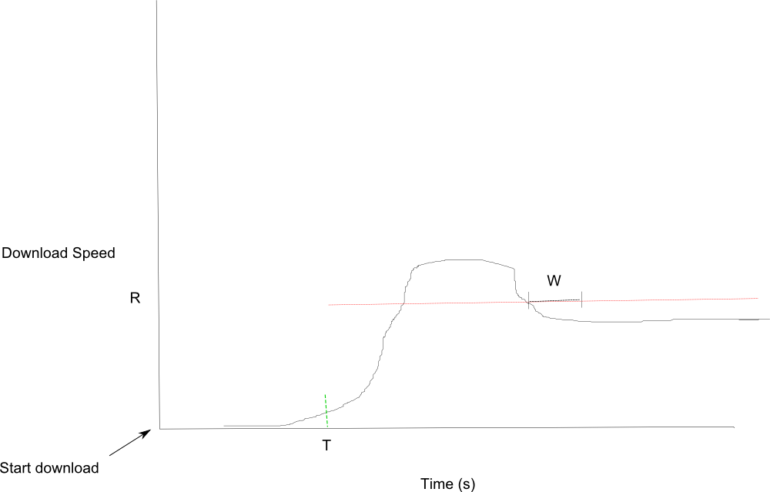
Monitor Download

Slide 14
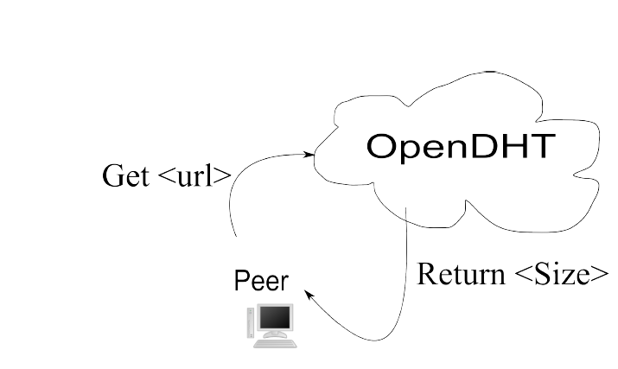
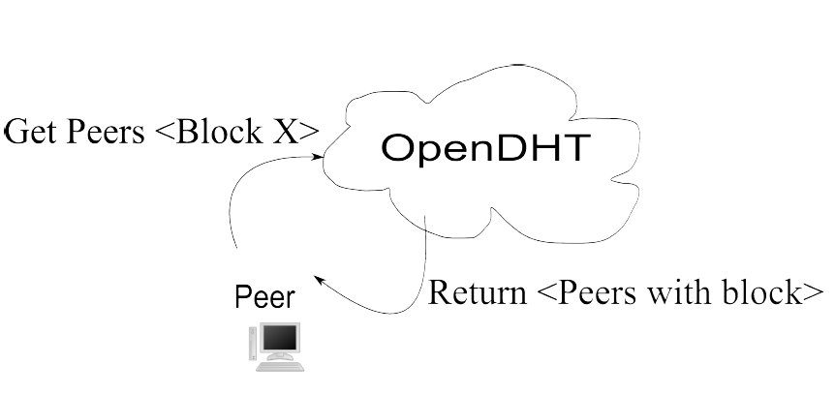
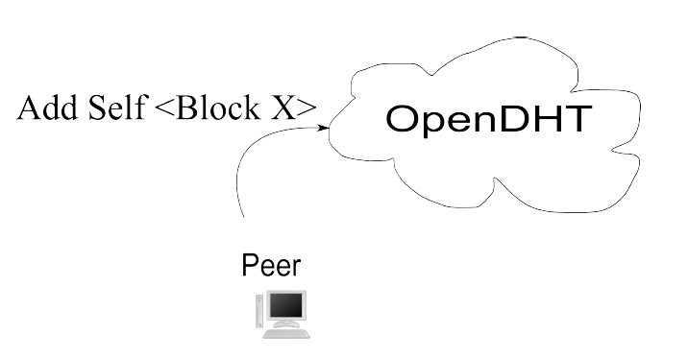
P2P: Transition
Notes:
Convert this and the next one to mimic the description in the Thesis.
Make sure I define OpenDHT before using it.

Slide 15
Details
T starts immediately.
R is calculated W seconds after T
Private OpenDHT instance.
Redundant DHT keys/gateways.
Polls on lack of peers (1s)
Downloads block from origin
Per block lists.
Last block problem

Slide 16
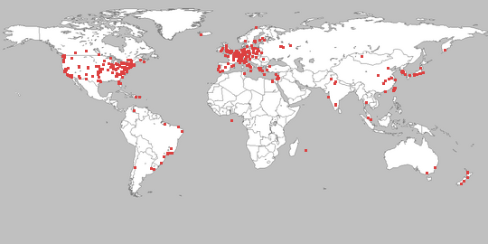
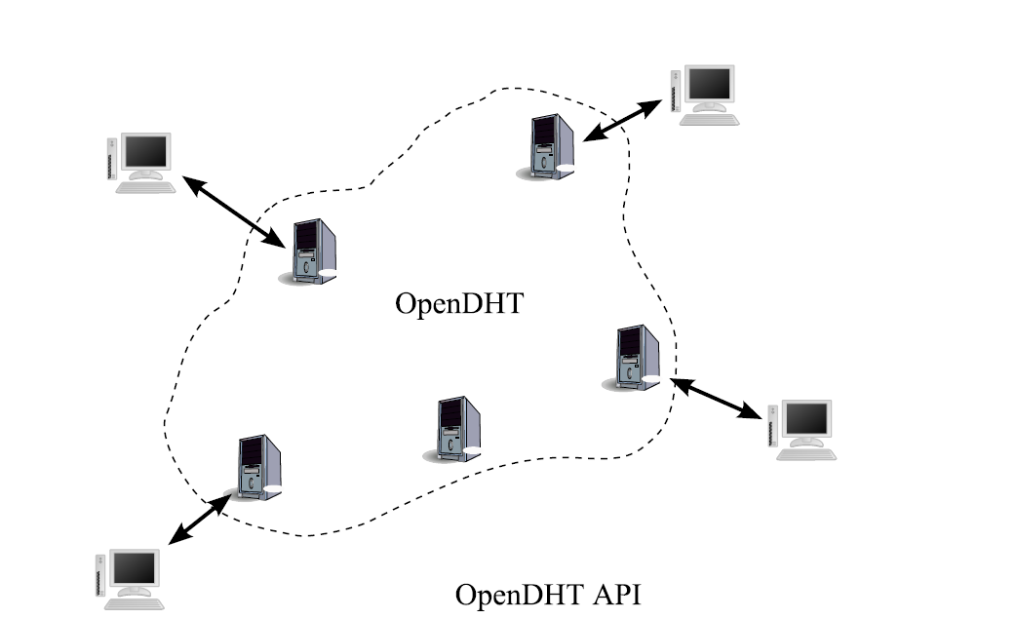
Methodology
PlanetLab
Private OpenDHT

Slide 17

Methodology
Run until finish.
Repeat 3x.
Graph percentiles of:
download times
DHT response times
causes for transitioning to P2P
BYU server
256 KB/s
Notes:
How many peers. (load)

Slide 18
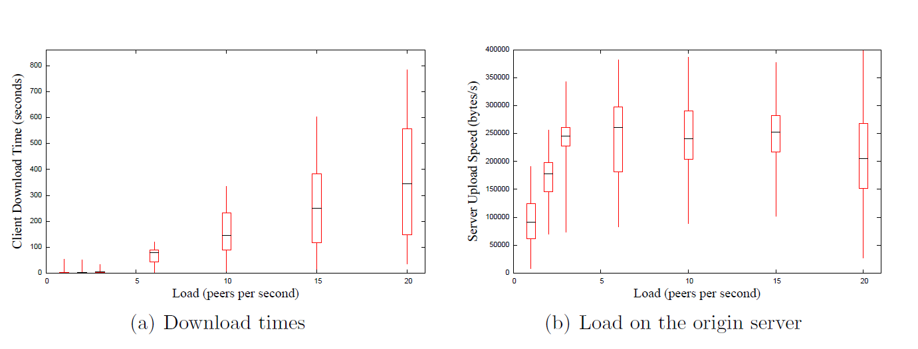
Performance Client-Server
File size: 100 KB, R 128 KB/s, W 2s, T 1s, Linger 60s. Increasing number of startup peers.
Notes:
Describe what did, then the results.
Note that a semi-popular website might serve half a
million hits a day, which averages to 6 per second, so our limit of 20 per second is similar, if
you take into consideration spikes in load.

Slide 19
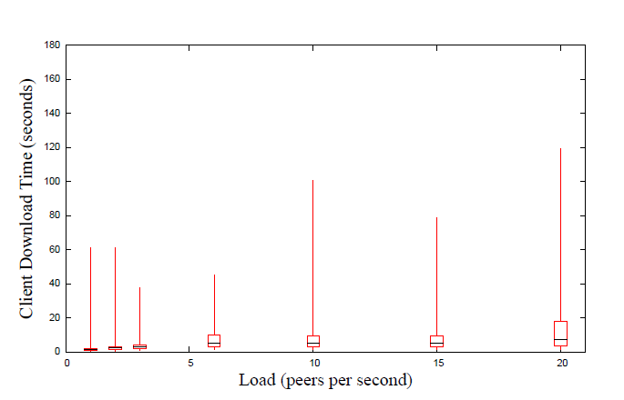
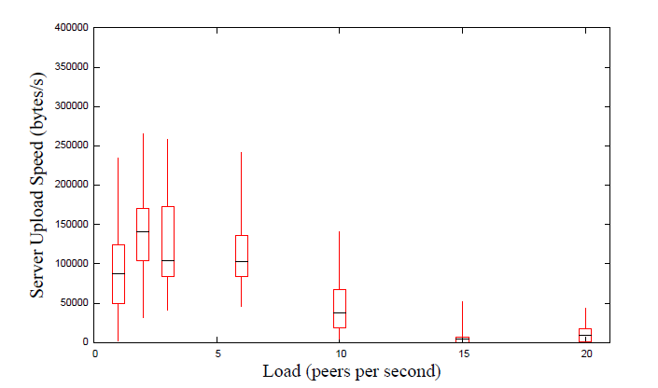
Performance – Automatic Swarming
99.5% transition because of T.
DHT latency of 5.2 seconds.

Slide 20
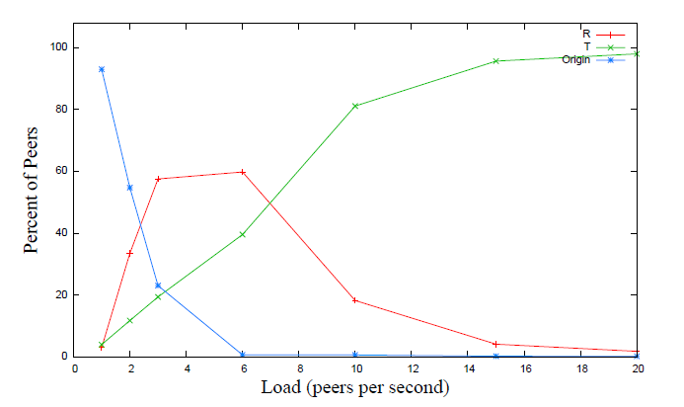
Automatic Swarming Transition Cause
R is server speed too slow.
T is
Notes:
TODO finish.
R – x
T – y (one line)

Slide 21
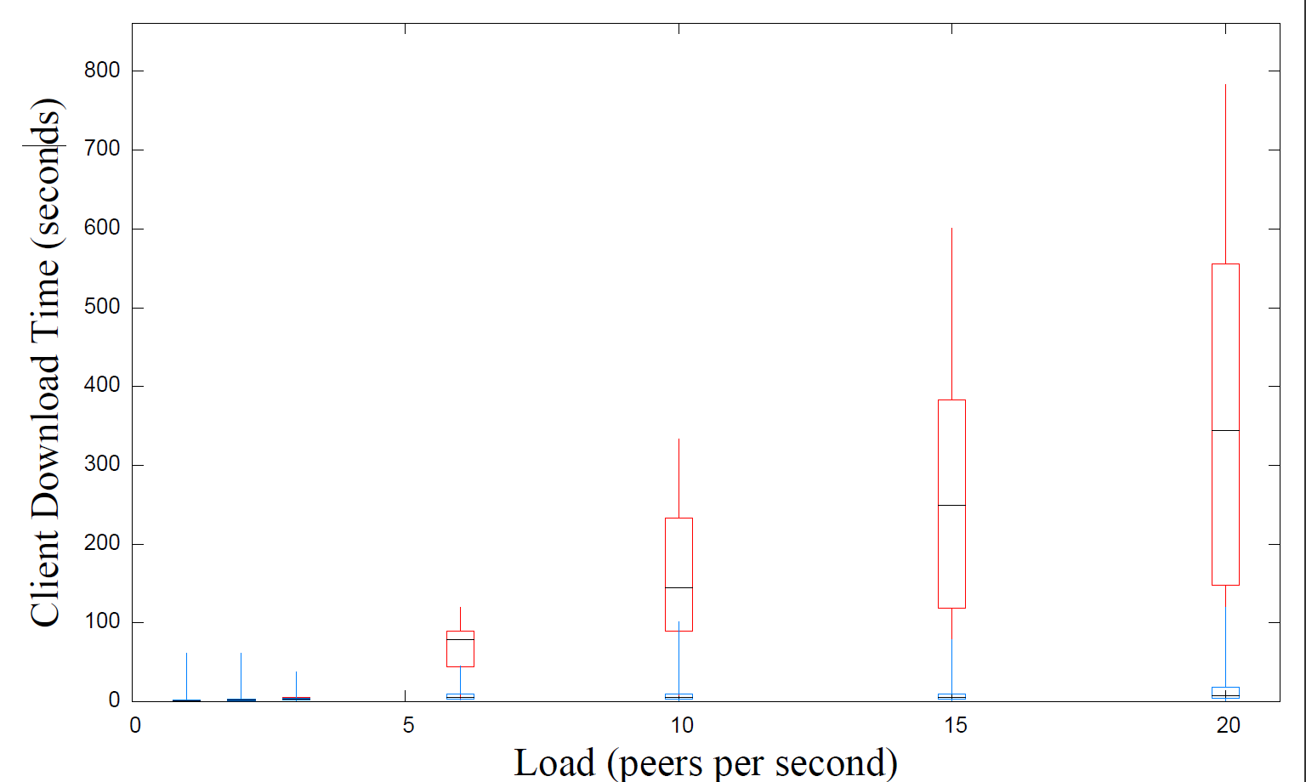
Compared
Notes:
Add 30x faster

Slide 22
Effect of Varying Parameters
T, R, W
Multiple Files
Large Files
Block Size
Linger Time
Peer count
1000 peers at 15/second (66 seconds).
100 KB file, 100 KB block size, conn. Limit 5, R 128 KB/s, T 1s, W 2s, Linger 20 s.
Notes:
Summarize in text (one slide), the optimal settings for t,r,w, block size. (for this server, this work load).

Slide 23
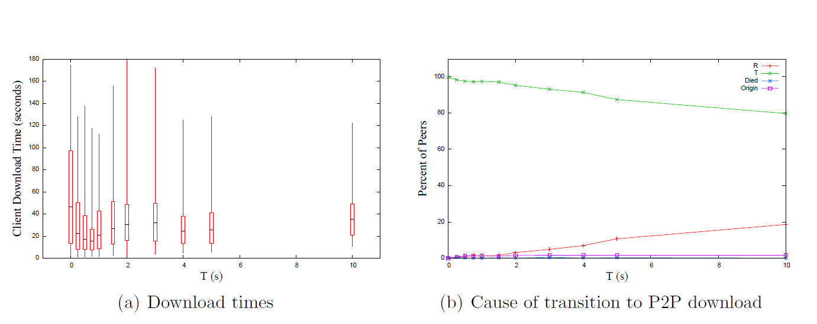
Varying T

Slide 24
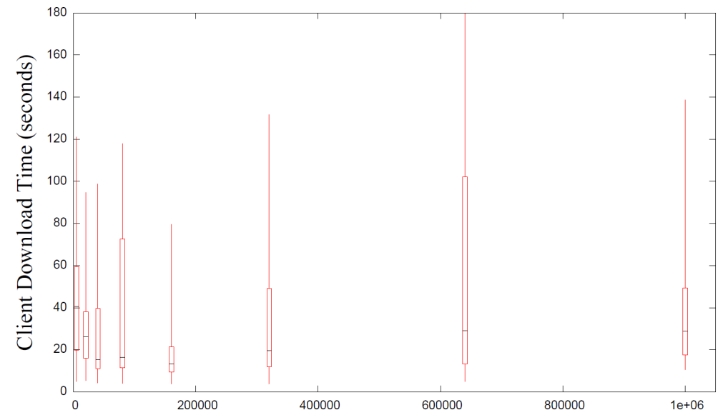
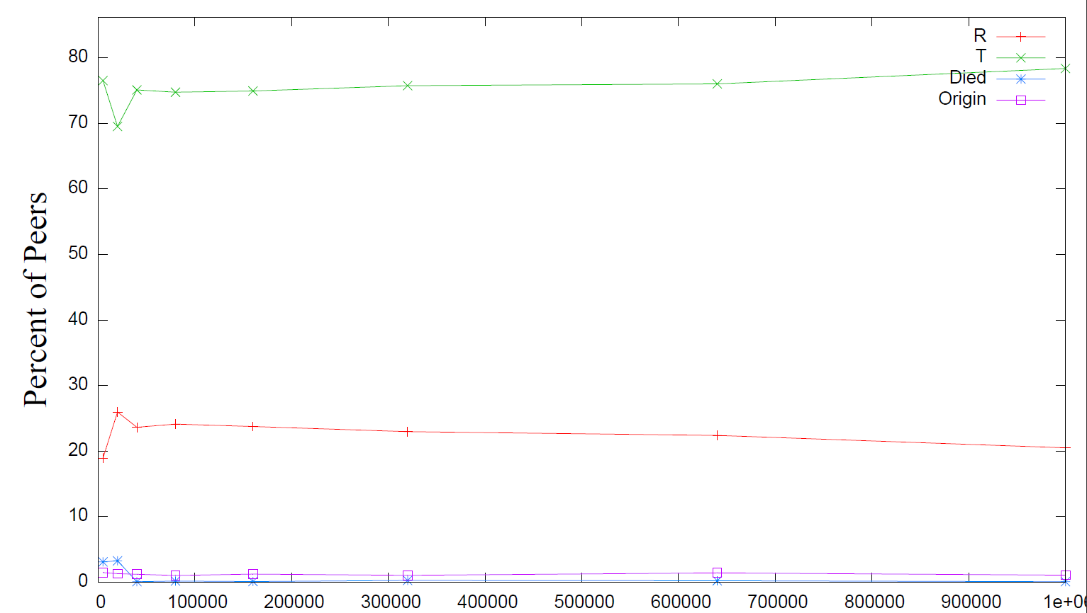
Varying R
Lower is better

Slide 25
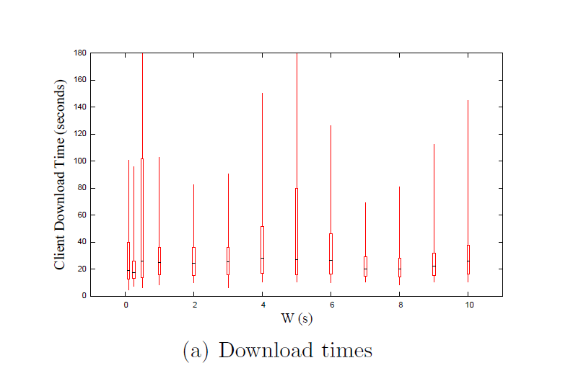
Varying W
Best time was 17 seconds with W at 0.25 seconds.
Rest about 25 seconds.
Lower is better, causes quicker transition, but not much difference.
Notes:
Similar change to R. Because it only affected at most the first few, because after that the server became saturated and T would always fire first.
Probably want that “other” graph in here, too, then, to show “oh it’s all T”?

Slide 26
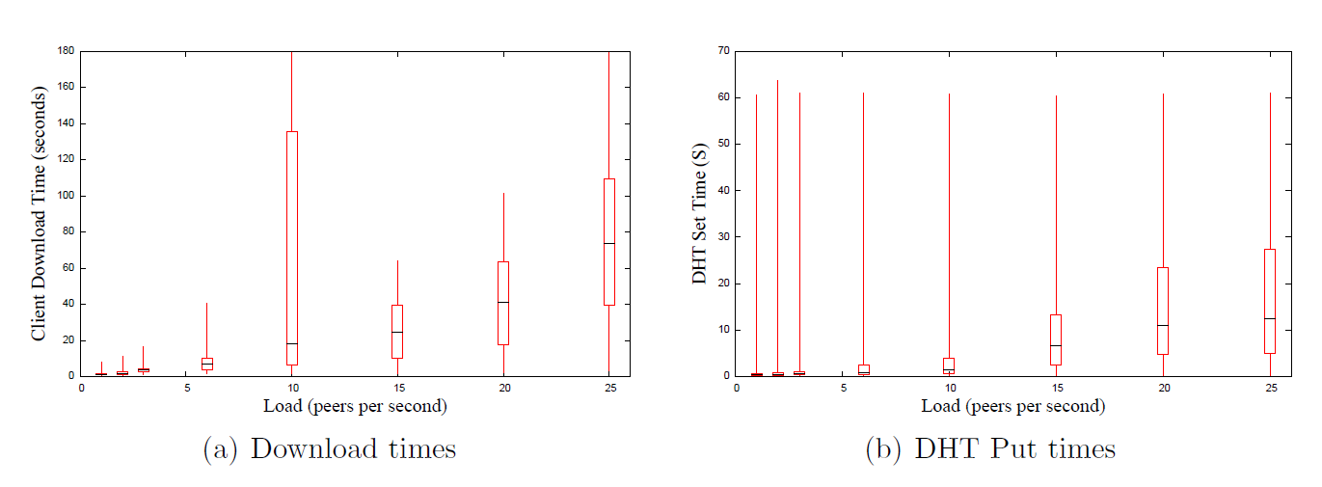
Full web Page
100 KB file, 10 15K files.
10 x as much load on the DHT.
Linger time was set to 20 seconds.
Notes:
Note that our linger time was 20 seconds, so the DHT was becoming less effective under higher load.
This is essentially like 10 times as much load as we were putting on the system before.

Slide 27
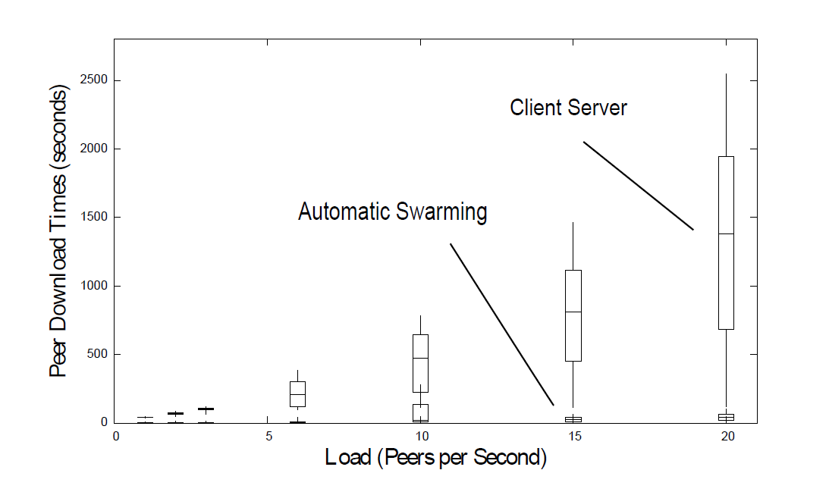
Multiple Files Versus Client-Server

Slide 28
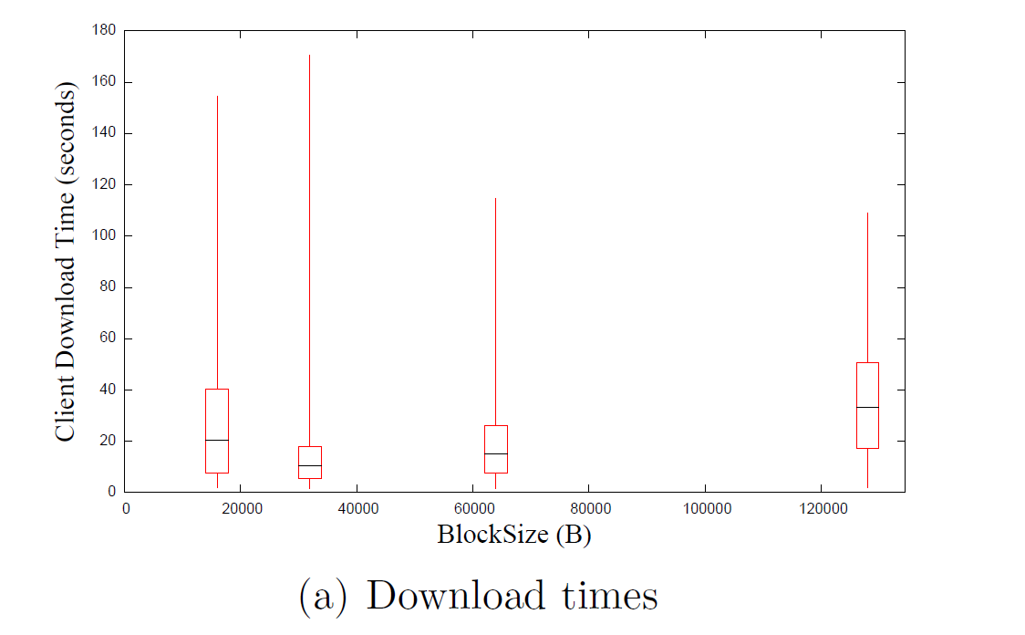
Block Size
10.6 seconds for 32 KB blocks.
Connection limit was 5, so all blocks in parallel.
Notes:
Fastest was 32 KB, presumably because I download from the last few peers in parallel, so this fits best.

Slide 29
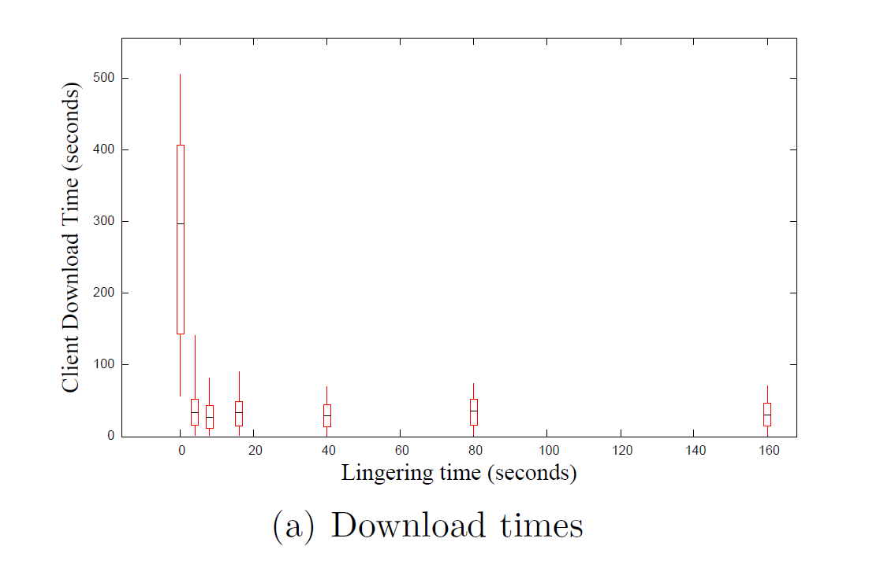
Linger Time

Slide 30
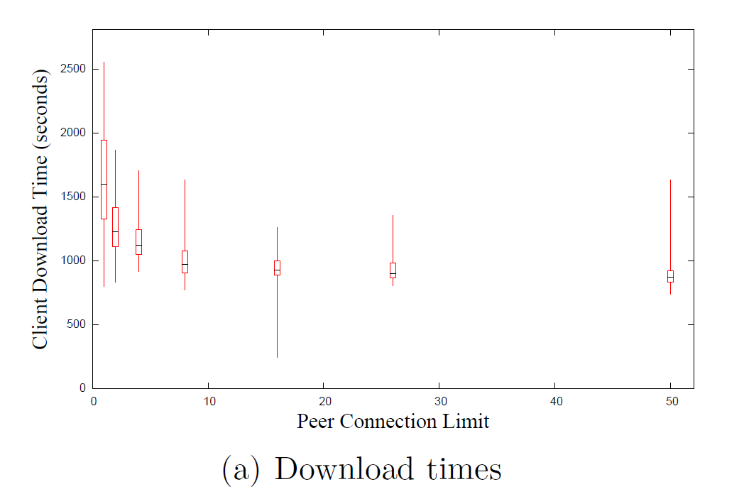
Peer connection
30 MB file.
Notes:
Take this one out!

Slide 31
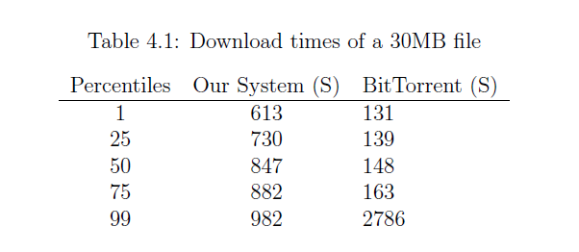
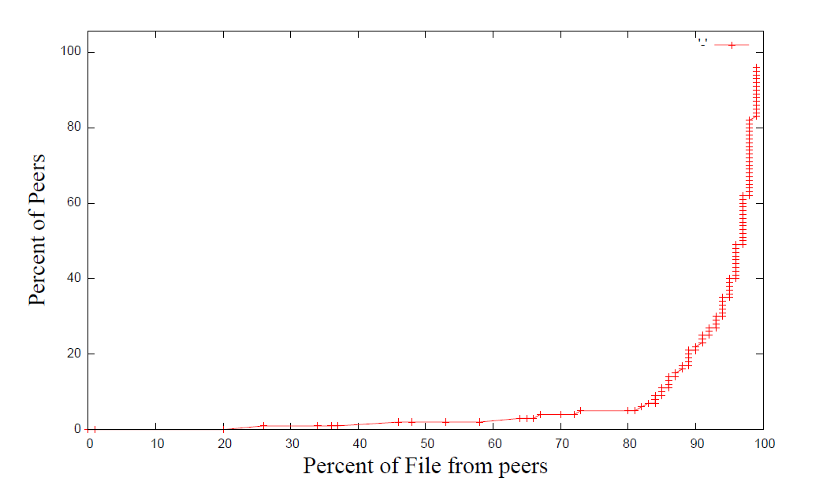
With Large Files
Fast once it gets started for both.
Notes:
“Ours doesn’t perform as well as BT for large files.”
You can see that at about 730 to 882 seconds most of our peers finish the file, and most of the peers download it from peers, so once we get the file out there we work all right, but we could do some work still to increase our speed of propagating the blocks.”

Slide 32
BitTorrent’s Large File Optimizations
Seeds limit outgoing connections.
Favors stronger connections.
Dedicated tracker.
Rarest Block First.
Notes:
We're not entirely sure why BitTorrent is faster.
One factor aecting performance is that BitTorrent's seed limits outgoing connections to
7, whereas Apache's connection limit is 256. This may allow BitTorrent to propagate full
blocks more quickly to peers. BitTorrent's seed also favors peers with higher download
speeds, which may help propagate blocks. In this test, it uses a dedicated tracker, which
makes peer rendezvous quicker than using a DHT. BitTorrent uses a \rarest block rst"
selection policy, enabling it to choose blocks more eciently.

Slide 33
Conclusion
Feasible transition to Peer-to-Peer download
30 x as fast for small files (flash crowd)
20x as fast for web pages
Reduces load on the server
Make swarming more usable/adoptable
Notes:
I *wish* I could c
Best settings
T: 0.75 s
R: 160 KB/s
32 KB blocks
Peer limit: 16
Linger: 16 s
onclude it worked well for larger files, too, but I guess I can’t say that.

Slide 34
Automatic Swarming -- Goals
Work for any file on any server without configuration.
Easy for client use.
No extra dedicated hardware.
Work for small files.
Non intrusive.

Slide 35
Future Work
Improve DHT performance
Improve automatic swarming for large files
General performance tuning and dynamic selection of parameters
Better use of the DHT
Staleness
BitTorrent features
Validate Integrity
Incentives
Notes:
Where immediately effective:
Low bandwidth server.

Slide 36
Questions

